Slide 1
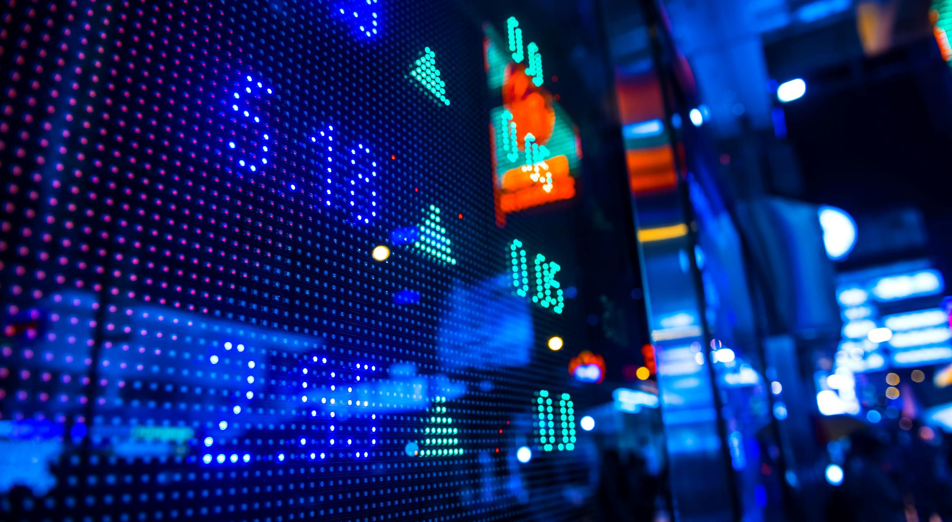

Sign language recognition app project
B21 – CAP0436 :
Andi josua simanullang lie Reynaldo ivander gunawan
Nafarel triyoga maskuncoro hezkiel rivaldo siregar
Nur ardli rachmat saputra darell adham kumara damaraji

Slide 2

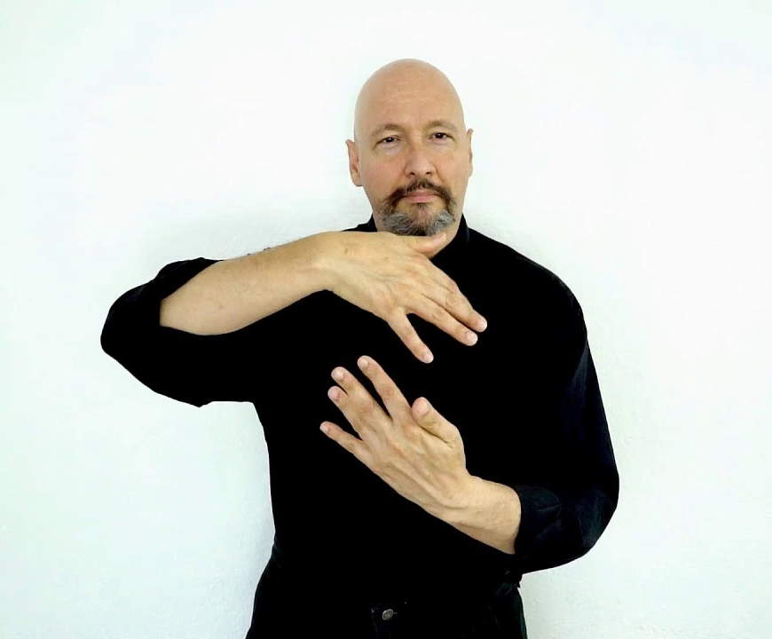
overview
We have created an android app that helps people to communicate with the deaf. This app implements machine learning to translate sign language to letters. we use the android camera to capture the user's hand image and send the image to the cloud to be processed by machine learning and the output will be shown in the app after receiving the result from the cloud. We use Convolution neural Network modeling to perform sign language recognition.
Currently, the sign language that can be recognized by
this system is American Sign Language. Just by capturing motion sign language with your phone's camera, the machine learning model in this app will translate it to you.
In the future this application will be developed to enable two-way communication. The features in this application are also still very potential to be developed and improved reliability. This application was created to facilitate community communication with the deaf, and expand opportunities for them in society.

Slide 3

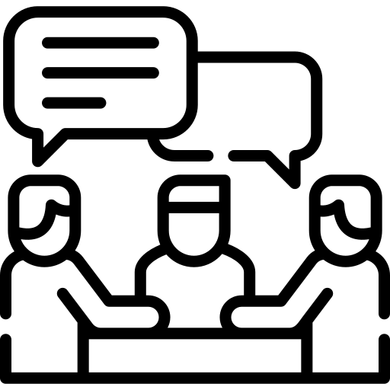
Based on data from the Ministry of Health's Pusdatin in 2019, of all persons with disabilities, 7.03% were deaf and 2.57% were speech impaired. Source : https://pusdatin.kemkes.go.id/resources/download/pusdatin/infodatin/infodatin-tunarungu-2019.pdf
There are still many people who do not understand sign language so that it is difficult for them and the community to communicate with each other.
BACKGROUND

Slide 4
dataset
The dataset format is patterned to match closely with the classic MNIST. Each training and test case represents a label (0 - 25) as a one-to-one map for each alphabetic letter A - Z (and no cases for 9 = J or 25 = Z because of gesture motions). The training data (27,455 cases) and test data (7172 cases) are approximately half the size of the standard MNIST but otherwise similar with a header row of label, pixel1,pixel2….pixel784 which represent a single 28x28 pixel image with grayscale values between 0 - 255
Link Dataset :
https://www.kaggle.com/datamunge/sign-language-mnist/code

Slide 5
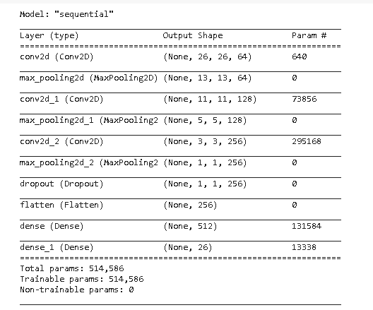
CNN MODEL BASELINE

Slide 6
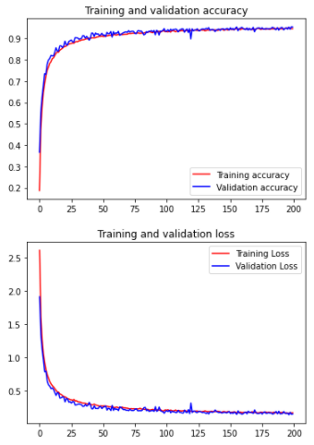
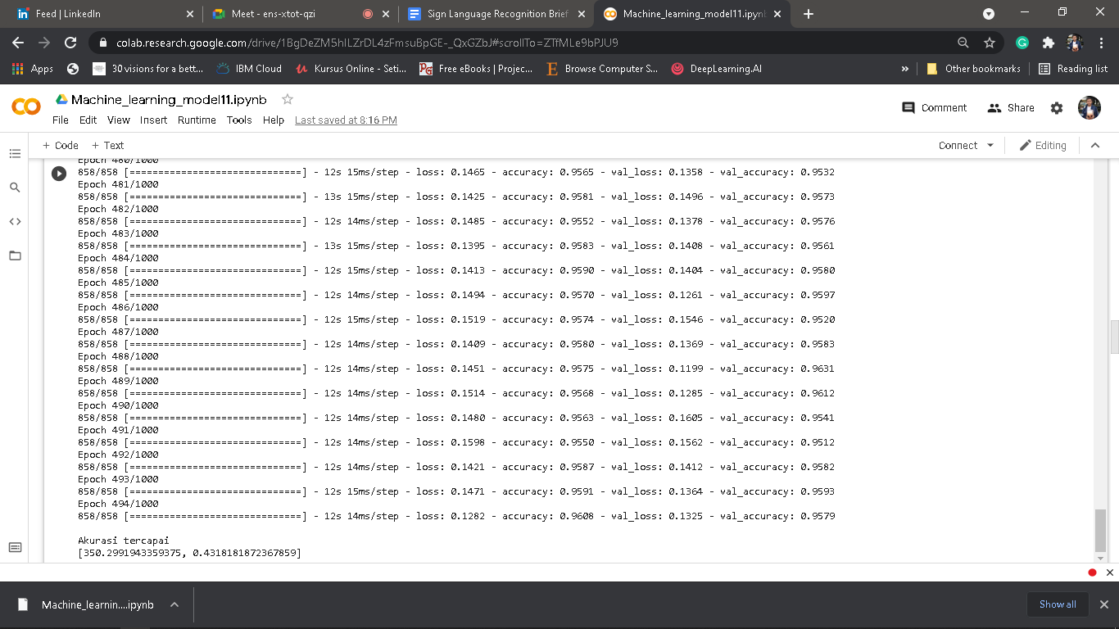
CNN MODEL RESULT

Slide 7
OUR IMPROVEMENT
ADDING DROPOUT LAYER
The Dropout layer randomly sets input units to 0 with a frequency of rate at each step during training time, which helps prevent overfitting

Slide 8

ANDROID IMPLEMENTATION
We are using CameraX to get android camera permission, capturing image, and saving
the captured image to the application storage.

Slide 9

ANDROID IMPLEMENTATION
We send the captured image to firebase storage so the cloud can take the image to
process it on the Machine Learning model and using firebase firestore to save the result.

Slide 10
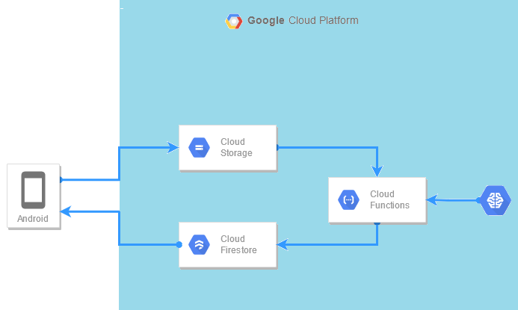
CLOUD’S SCHEMA
Machine Learning Model deployed with Cloud Function as a Serverless Machine Learning.
Cloud Function triggered by finalize/create from Cloud Storage. After Machine Learning predict the input, Cloud Function then forward the result to Cloud Firestore.
Android application upload the image to Cloud Storage to trigger Cloud Function, then Pull the expected result from Cloud Firestore.

Slide 11
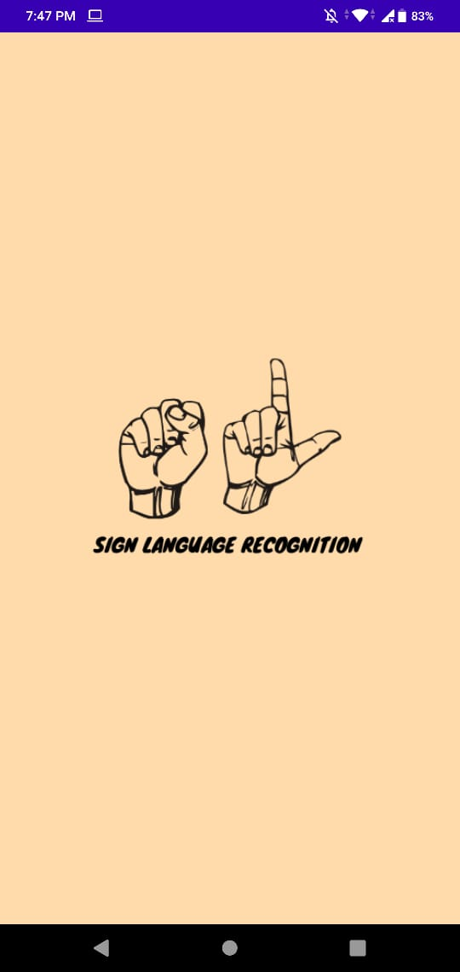
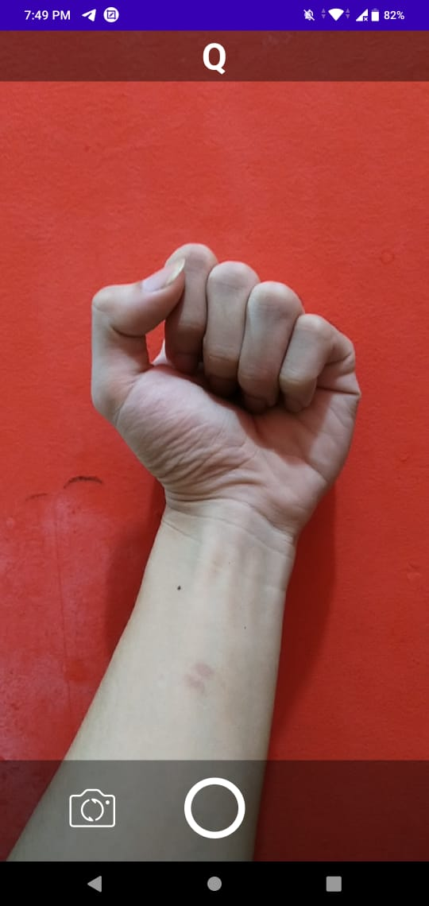
DEPLOYMENT
Our project application deployed only in Github.
https://github.com/envyst/sign-language-application/blob/master/sign-language-app.apk
And the Machine Learning deployed on Google Cloud Platform using Cloud Function as a Serverless Machine Learning.
Using a simple interface, our users can just take a picture about sign language and then get the result of translation from it.

Slide 12





Thank You
Allan Mattsson
+1 555-0100
allan@contoso.com
www.contoso.com

